Slide 1
GloCal Health Fellowship Career Development Webinar Series
Chunqing Lin PhD.
Assistant Professor-in-Residence
Department of Psychiatry and Biobehavioral Sciences
University of California, Los Angeles

Slide 2
EDUCATION
EMPLOYMENT
RESEARCH
TEACHING
2003
MBBS (Clinical Medicine), SYSU
Research assistant, China CDC
Research assistant:
Stigma reduction among service providers
2004
Graduate Student, UCLA
2005
Graduate Student Researcher, UCLA
Dissertation:
Implementation of MMT programs in China
2009
PhD (Epidemiology) UCLA
Research Associate, CUHK, Hong Kong SAR
Project Director:
MMT provider training in China
Empowerment for HIV affected families in China
Family intervention for people who use drugs in Vietnam
2011
Assistant Research Epidemiologist, UCLA
2013
Mentored Research:
Implementation science for intervention delivery in healthcare settings in China (K01)
UCLA-HMU Fogarty training program
2015
Assistant Professor-in-Residence, UCLA
Co-Investigator:
CHW capacity building in addiction/HIV care in Vietnam
Adaptation of EBI to improve transgender health in Vietnam
Principal Investigators
MMT/HIV service decentralization in Vietnam (R34)
Battling stigma among women with HIV in Vietnam (R21)
Improve PMTCT services for migrant women with HIV in China (UCLA AIDS Institute)
Integrated services delivery for MSM in China (CHIPTS)

Slide 3
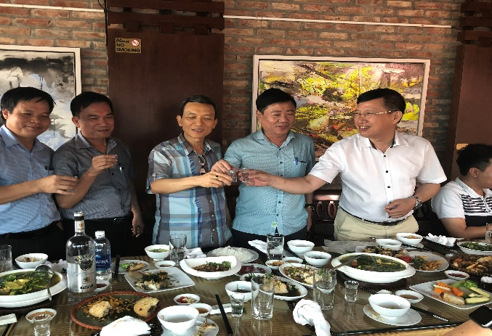
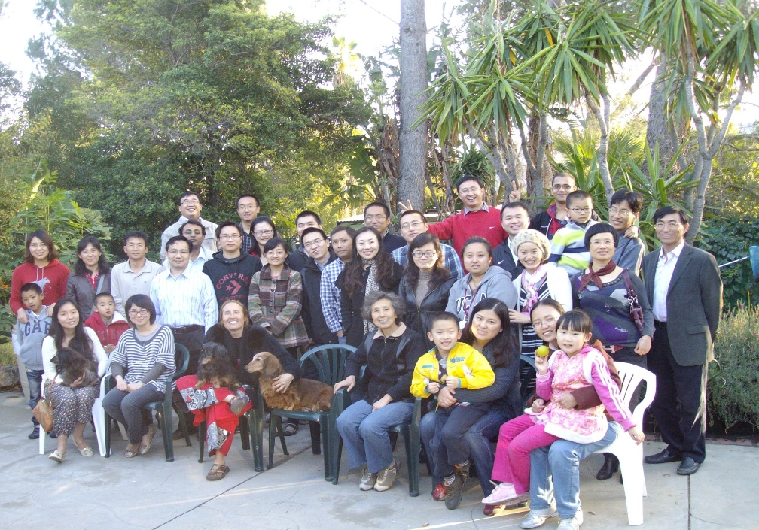
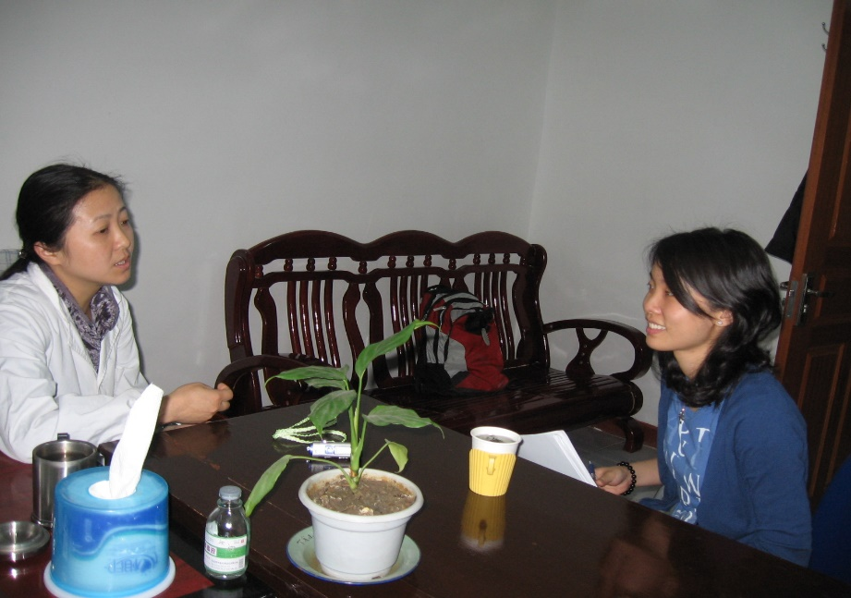

Slide 4
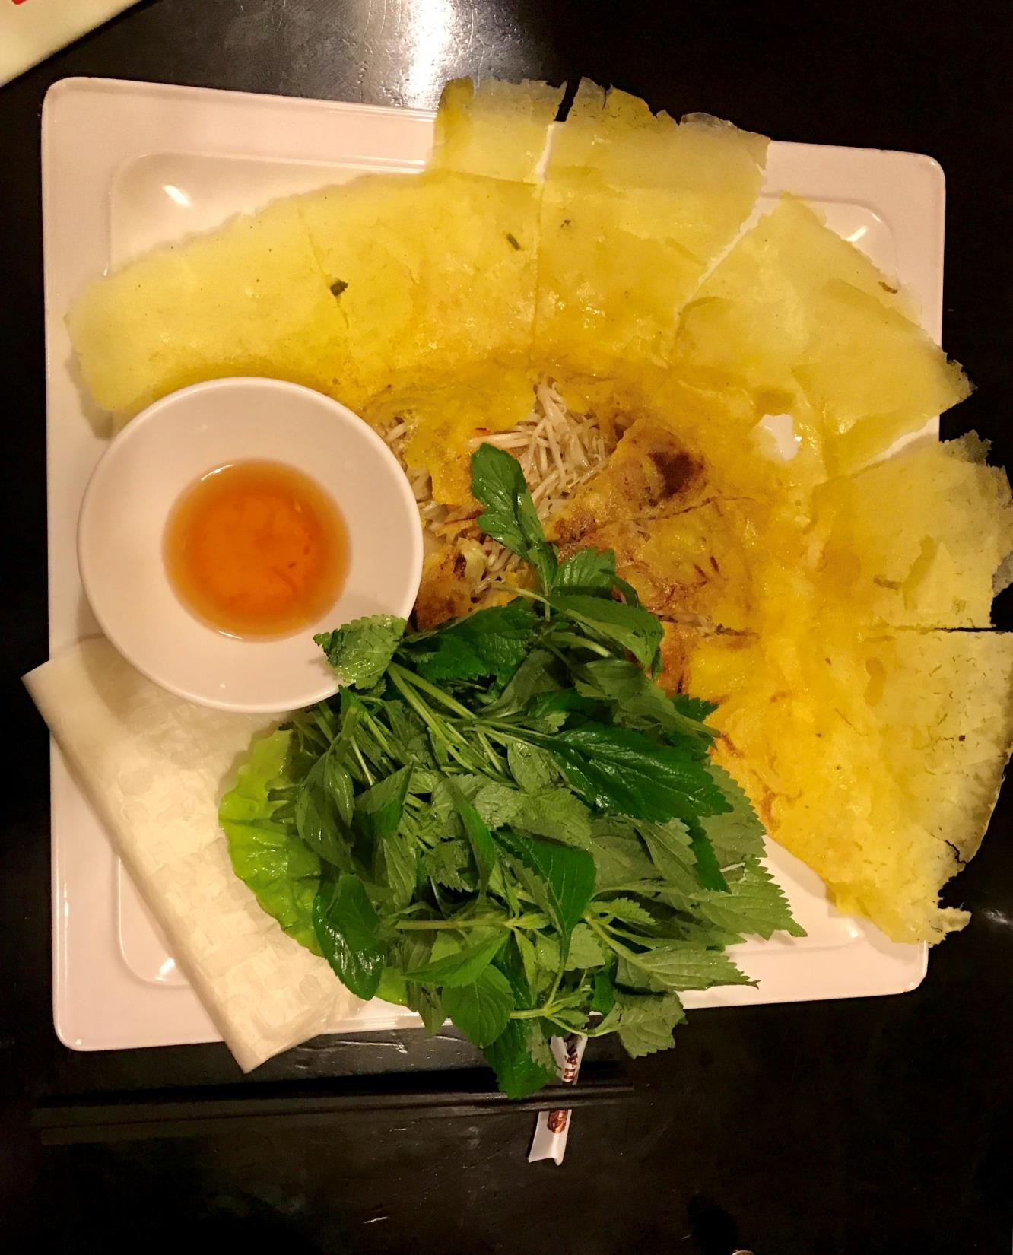

Slide 7
Acknowledgement
Funding:
K01MH102147
R34 DA043783
R21 TW012018
UCLA AIDS Institute, UCLA Center for AIDS Research (AI28697), UCLA Pediatric AIDS Coalition
P30MH058107
Mentors, Colleagues, and Collaborators

