Slide 1
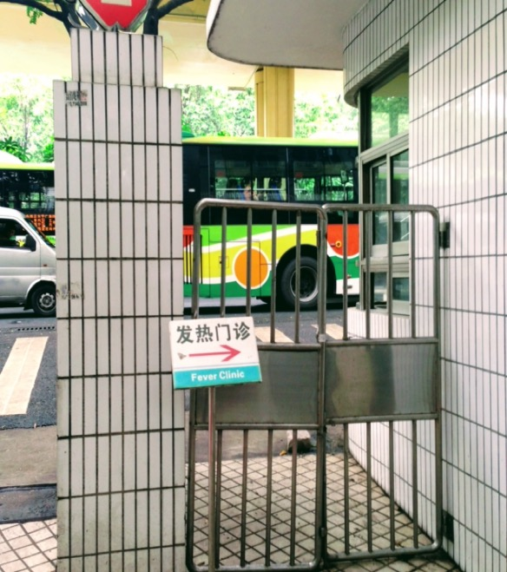

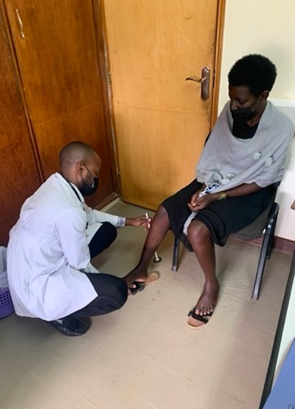
My career as a
“neuro-globalogist”
Felicia Chow, MD, MAS
March 22, 2023
University of California, San Francisco

Slide 2



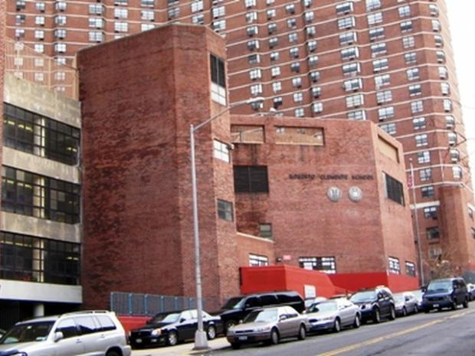
2000: Undergraduate degree in Neuroscience
2000-2: TFA middle school math teacher

Slide 3
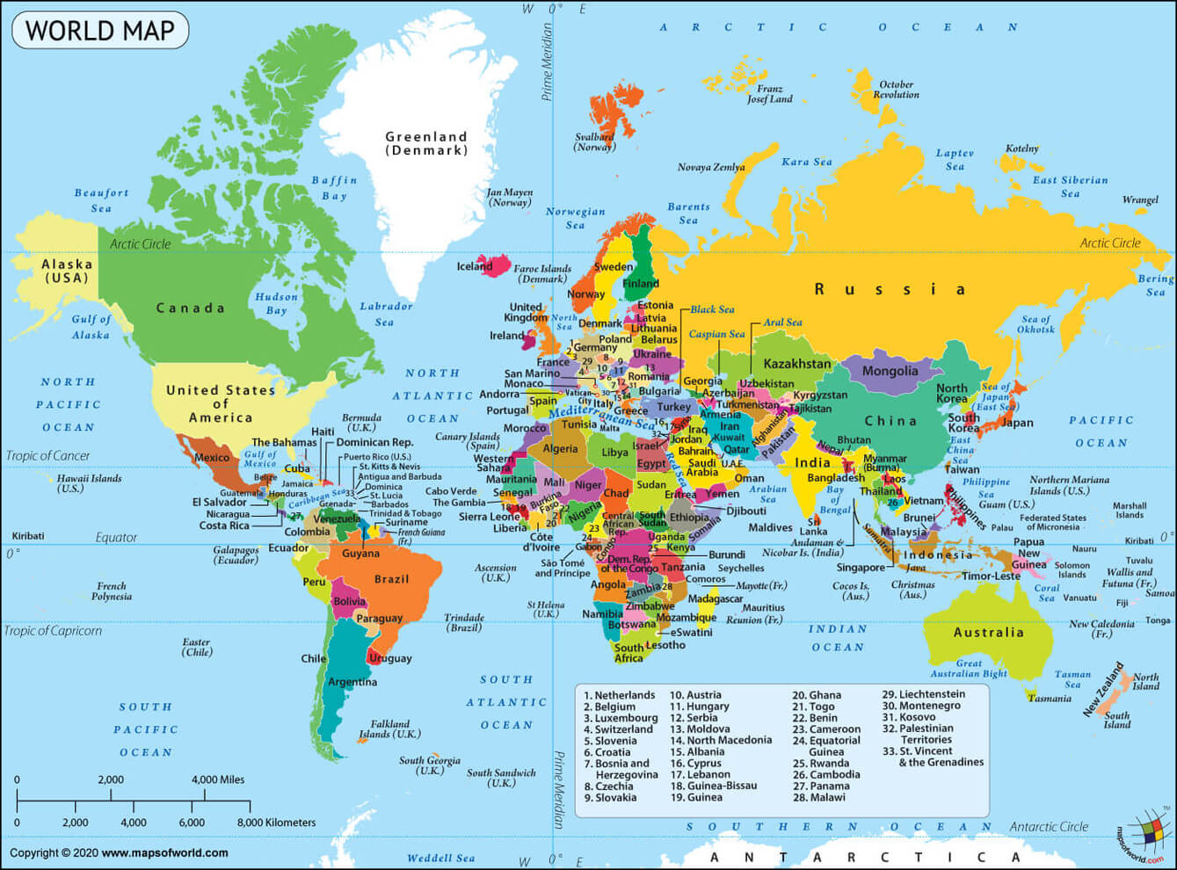

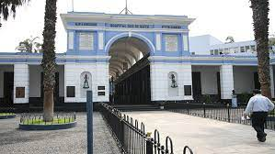
2002: Summer research experience during medical school at Hospital Dos de Mayo in Lima, Peru

Slide 4
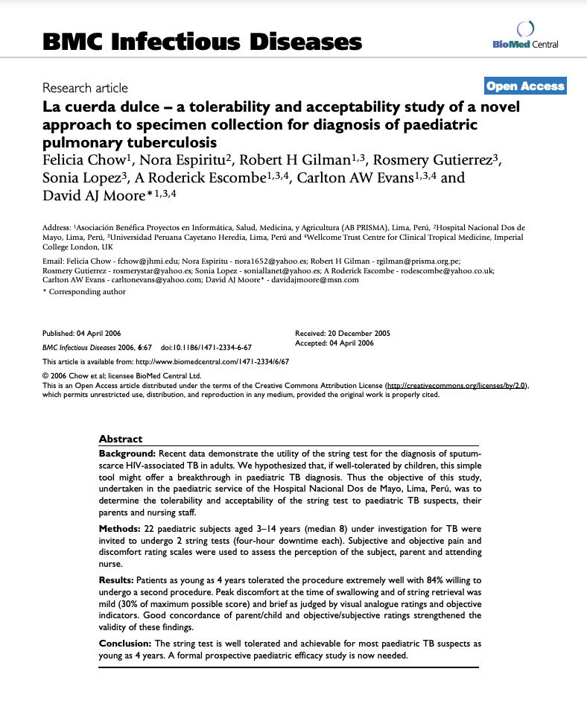
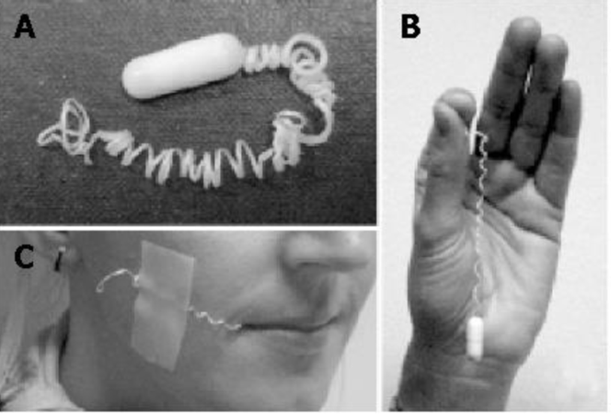

Slide 5
Show up and learn as much as you can from the first jump…
the focus of your first global health experience may shape what you do for the rest of your career

Slide 6
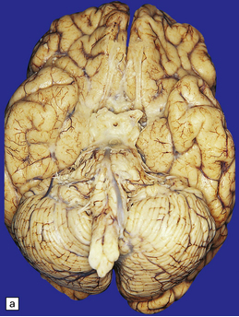
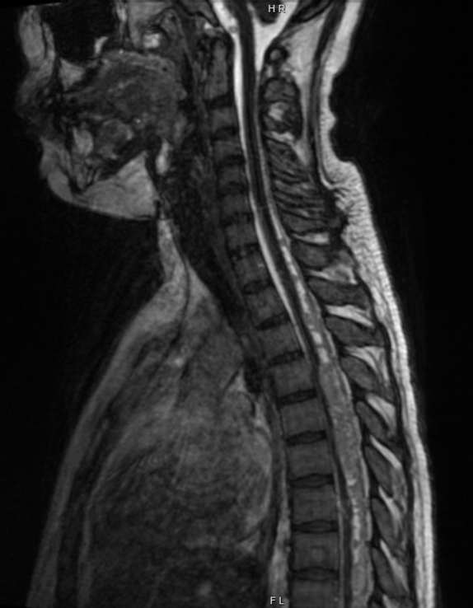
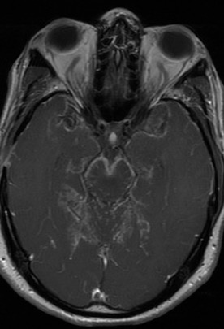



TB meningitis clinical trials

Slide 7
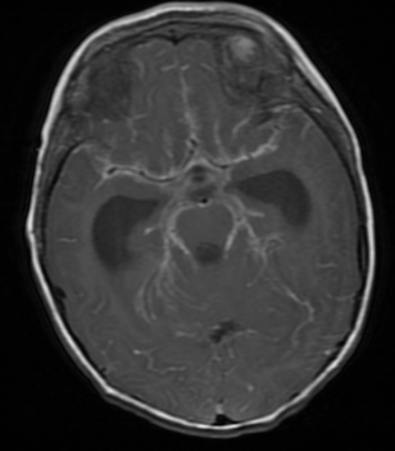
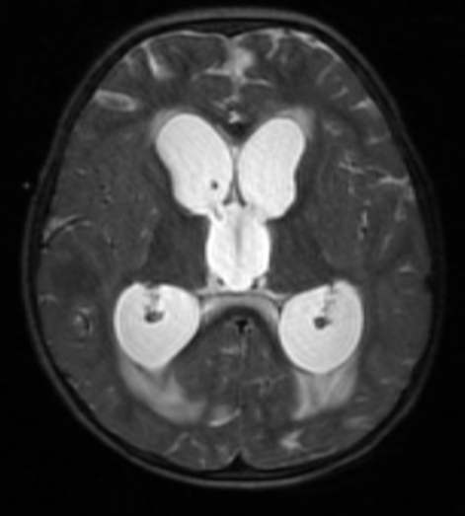
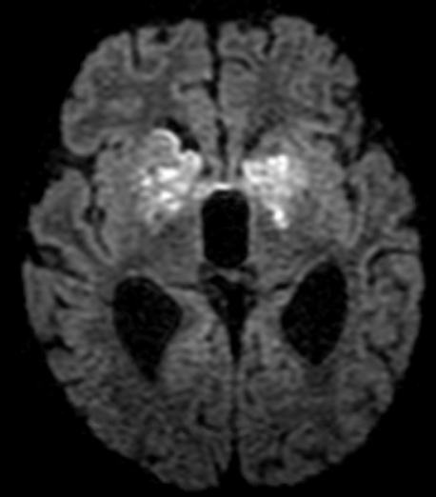
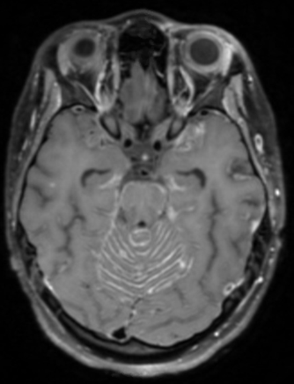
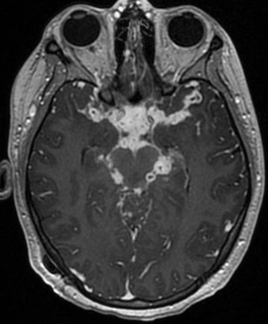
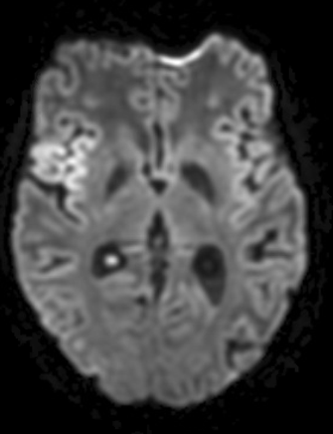
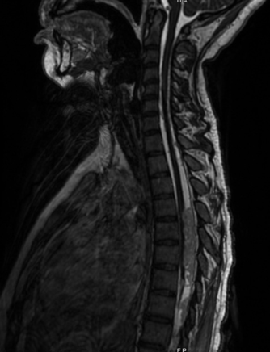
17-month-old, US-born male presented with fever, emesis, seizures
Xpert+ on trach aspirate; M. tb culture+, pan-sensitive
Mom was source case with matching genotype; diagnosed with LTBI a few years ago but never treated
Healthy 22-year-old woman from Mexico presented with fever, SOB, and paresthesias in lower extremities
Initially diagnosed with COVID and MISC-C
AFB culture+ on CSF, determined to be M. bovis

Slide 8
People living with HIV with TBM have worse outcomes
Mortality 20-35% among individuals without HIV and can exceed 50% for PWH
About half of survivors suffer from serious disability, no clear difference by HIV status
Of 636 individuals with CNS TB over 24-year period from CA TB registry, HIV associated with higher risk of death (25% vs 12%)*
Of 192 individuals with TBM over 7-year period in Texas, ~2-fold higher risk of death associated with HIV infection
65% vs. 28% mortality
Thwaites et al J Infect Dis 2005; *unpublished data from Pascopella, Barry from TB Control Branch, Surveillance and Epidemiology Branch, CDPH

Slide 9




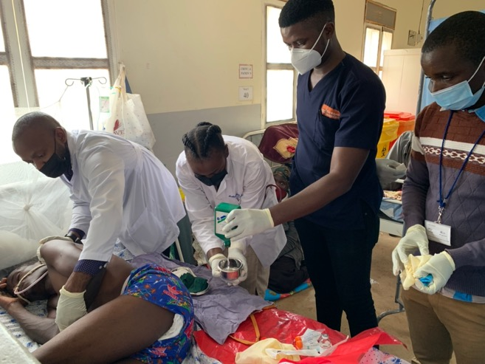
Pharmacokinetics and safety/tolerability of linezolid in adults treated for tuberculous meningitis: a preliminary analysis of the ALTER (Adjunctive Linezolid for the Treatment of TubERculous Meningitis) Trial
Freddie Mukasa Kibengo, MBChB, MMed, FCP, MSc
On behalf of the ALTER Trial team

Slide 10
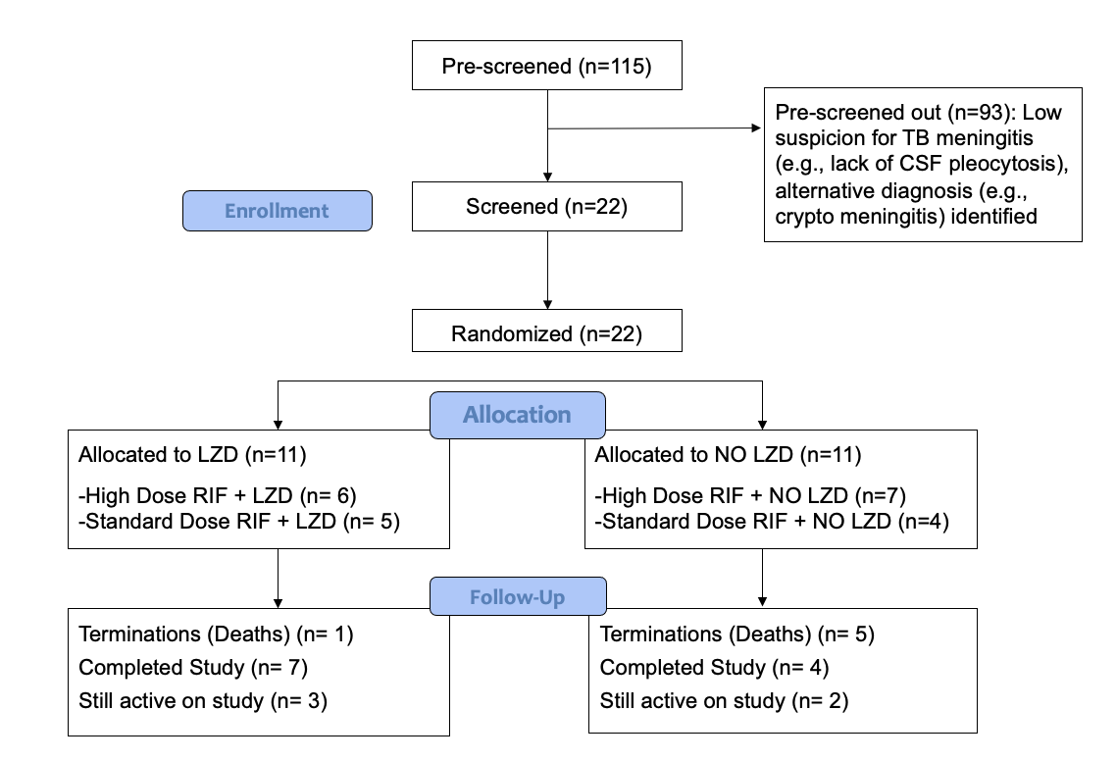
ALTER: Adjunctive Linezolid for the Treatment of TubERculous Meningitis
Objective: To investigate CSF and plasma PK and safety/tolerability of adjunctive LZD for first 4 weeks of TBM treatment in people with HIV
Study design: Phase II, randomised, open-label trial with a factorial design
Study setting: Rural hospital in southwestern Uganda
Randomization: 1:1 ratio to high (35 mg/kg) or standard dose RIF (10 mg/kg) with or without LZD 1200 mg daily stratified by TBM grade
Study enrollment started on 09 September 2021: 22 participants enrolled so far, PK analysis results available for first 15 participants

Slide 11
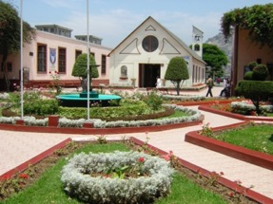
2005-6: Fogarty fellowship in Lima, Peru with Joseph Zunt at University of Washington

Slide 12
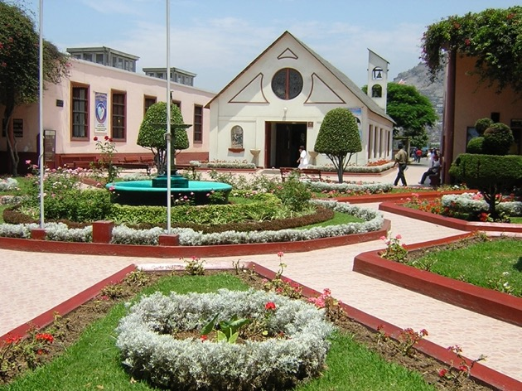
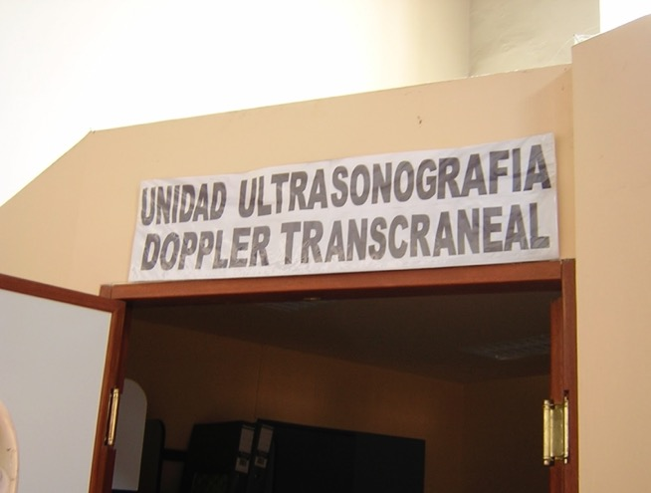
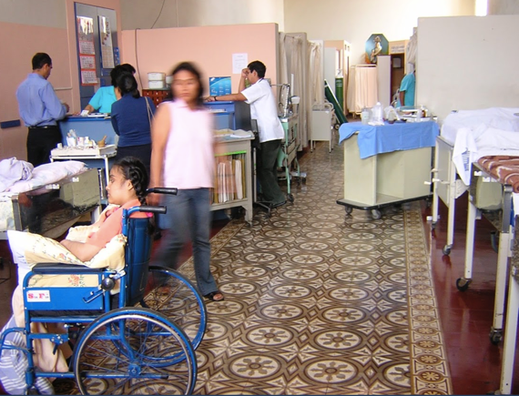
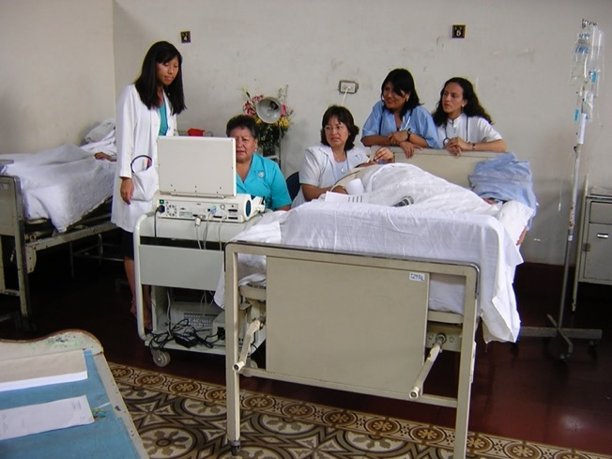
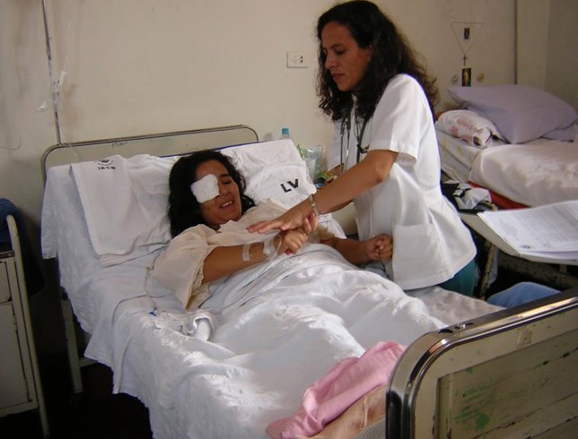
Primary project:
Use of transcranial Doppler ultrasound to detect cerebral vasculopathy in patients with subarachnoid cysticercosis
Mentors: Joseph Zunt, Silvia Montano, Hugo Garcia
Site: Instituto de Ciencias Neurologicas (Hospital Mogrovejo), Lima, Peru

Slide 13

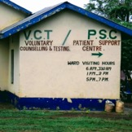
2010: Global health elective in Kisumu, Kenya with Ana-Claire Meyer during neurology residency at MGH/Brigham

Slide 14
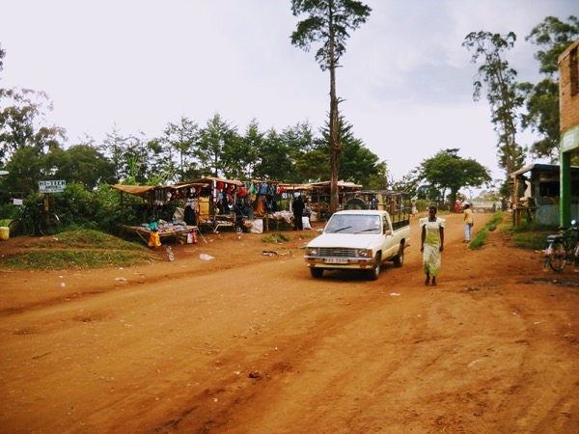
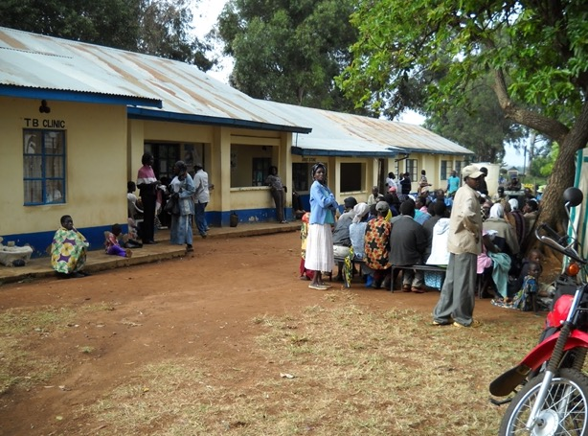

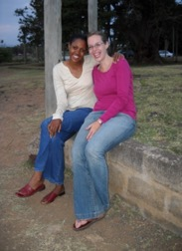
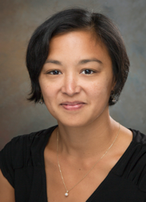
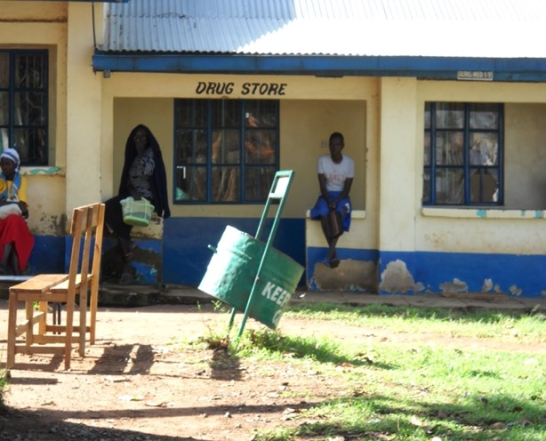
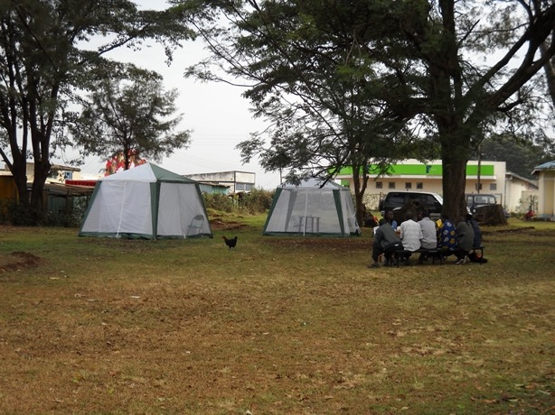
Primary project:
Use of transcranial Doppler ultrasound to detect cerebral vasculopathy in patients with subarachnoid cysticercosis
Mentors/Collaborators: Ana-Claire Meyer, Judith Kwasa, Deanna (Cettomai) Saylor
Site: UCSF Family AIDS Care and Education Services (FACES), Kisumu, Kenya

Slide 15
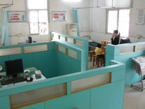
2011: Global health elective in Guangzhou, China during neurology residency at MGH/Brigham

Slide 16

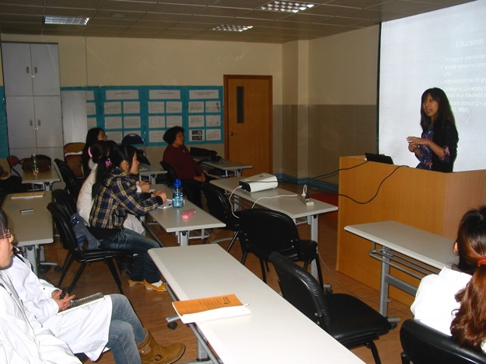
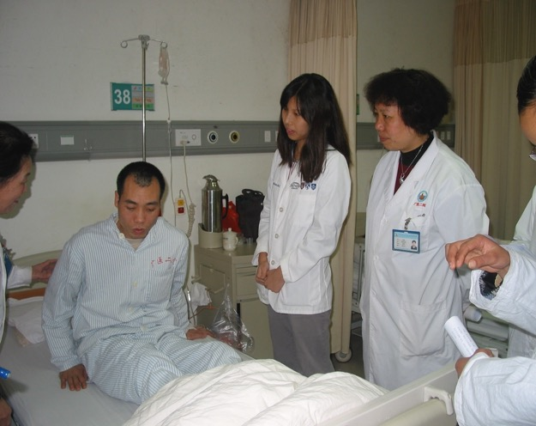
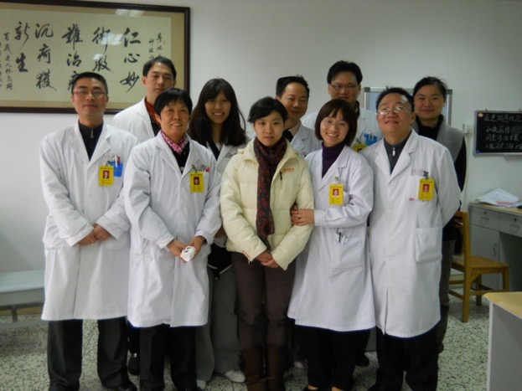
Primary project:
Evaluation of a community-based approach to stroke care in a rural setting in Guangdong Province, China
Mentors: Weiping Liao, En Xu
Site: Guangzhou Medical College, Institute of Neurosciences

Slide 17


2014-15: GloCal fellowship in Beijing, China with Dr. Taisheng Li at Peking Union Medical College Hospital

Slide 18
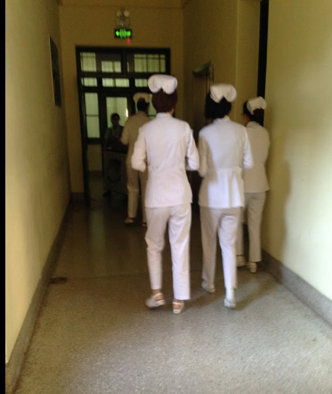
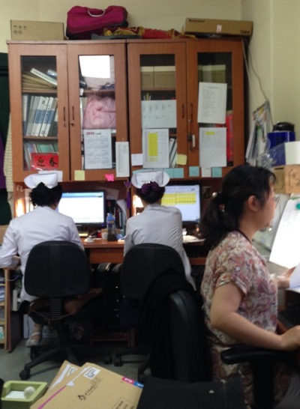
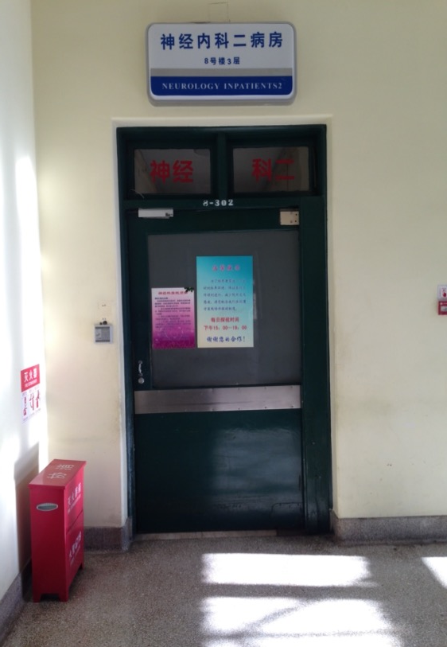
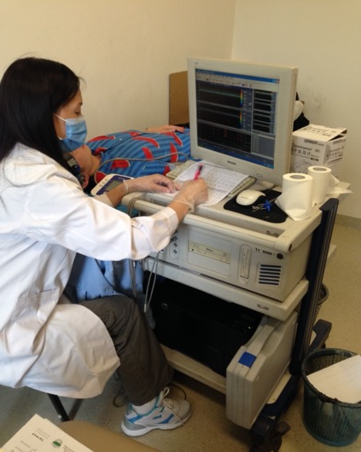
Primary project: A feasibility study of the transcranial Doppler carbon dioxide challenge to evaluate cerebral vasoreactivity in HIV-infected individuals in China
Mentors: Taisheng Li, Huanling Wang
Site: Peking Union Medical College Hospital, Beijing, China; Third People’s Hospital, Shenzhen, China

Slide 19
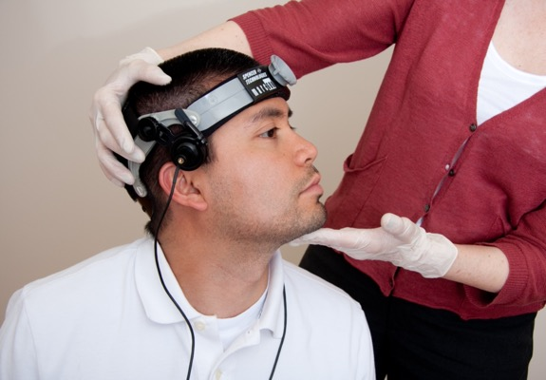

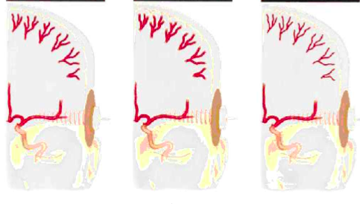
Effect of anti-retroviral therapy on cerebrovascular function
75 people with HIV in Beijing (mean age, 41 years; median time since diagnosis, 5 years)
100% ART-treated and virologically suppressed
Majority of participants on tenofovir or zidovudine | lamividuine | efavirenz, nevirapine, or lopinavir/ritonavir
Measured cerebral vasoreactivity, marker of cerebrovascular endothelial function associated with large artery & small vessel disease, using transcranial Doppler breath-holding challenge
Baseline Hypercapnia Hypocapnia
Chow et al. JAIDS 2016, Vernieri et al. 1999, www.swedish.org/services/neurosciences-institute

Slide 20
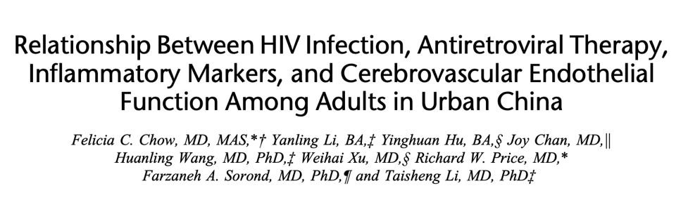
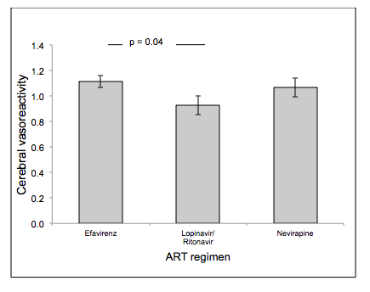
Lower cerebrovascular function among individuals on protease inhibitors
Use of lopinavir/ritonavir associated with lower cerebral vasoreactivity, independent of vascular risk factors, duration of ART use and time since HIV diagnosis
Chow et al. JAIDS 2017

Slide 21
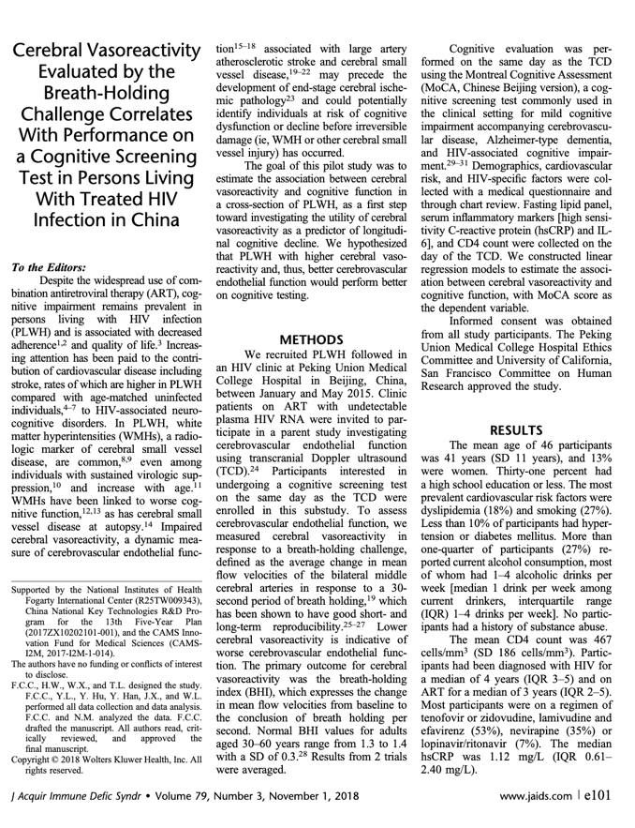
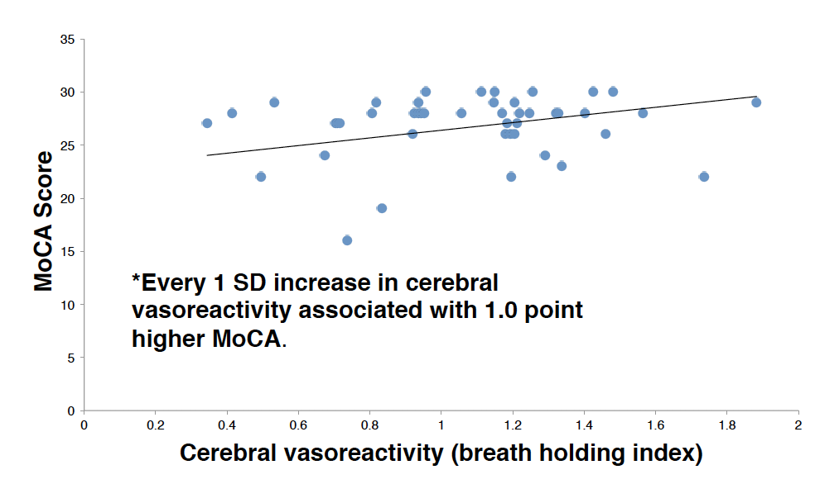
Higher cerebral vasoreactivity associated with better cognitive function
Chow et al. JAIDS 2018

Slide 22
Focus, don’t spread yourself too thin, learn how to say no…
But it’s okay to have a few irons in the fire.

Slide 23

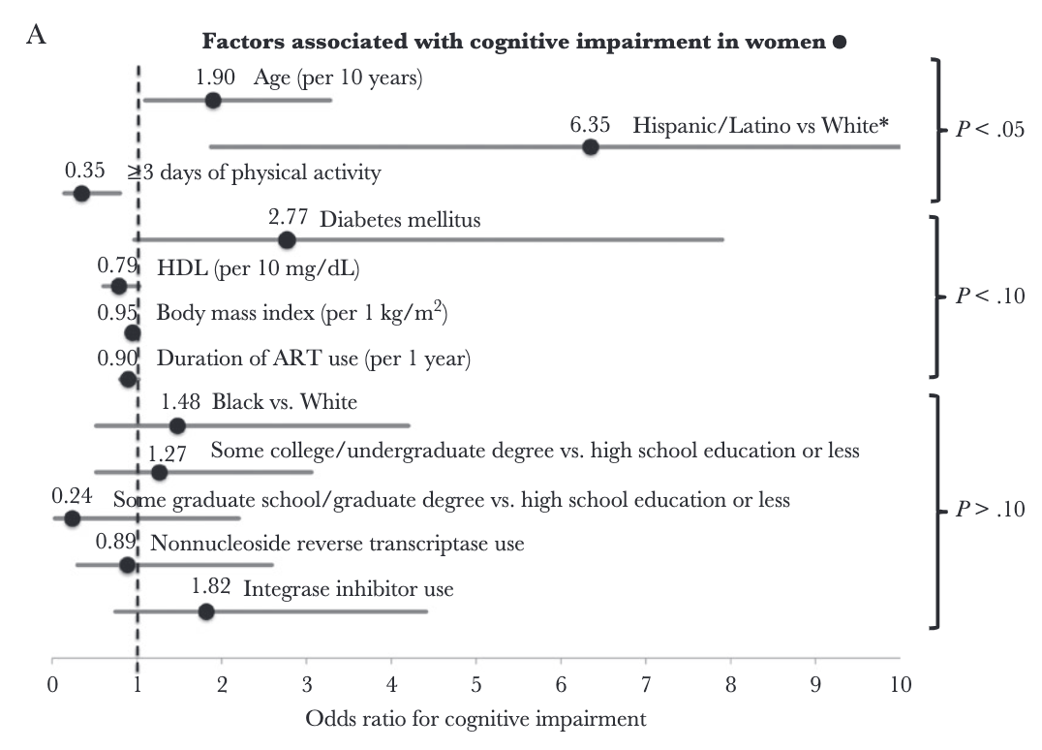
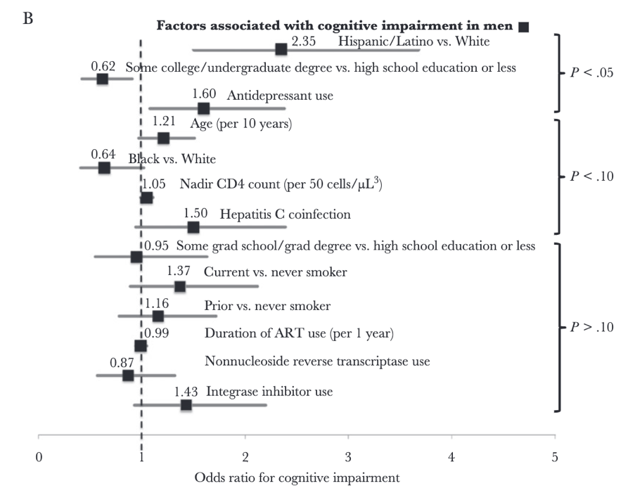


Greater negative impact of CVD risk on cognitive function in women than in men with treated HIV
A5322 (HAILO) Study
Chow, Makanjuola et al. J Infect Dis 2018

Slide 24

Greater negative impact of cardiovascular risk on cognitive function in women than in men with treated HIV
A5322 (HAILO) Study
 | All (n=988) |  | Women (n=195) |  | Men (n=793)
 | Effect on NPZ-4 (SE) | P value | Effect on NPZ-4 (SE) | P value | Effect on NPZ-4 (SE) | P value
Atherosclerotic CVD risk score (per 1% higher risk) | -0.29 (0.39) | 0.46 | -2.29 (0.67) | <0.001 | -0.002 | 1.00
Framingham risk score (per 1% higher risk) | -0.09 (0.23) | 0.70 | -1.45 (0.49) | 0.003 | 0.02 (0.27) | 0.93
Chow et al. Clin Infect Dis 2020

Slide 25
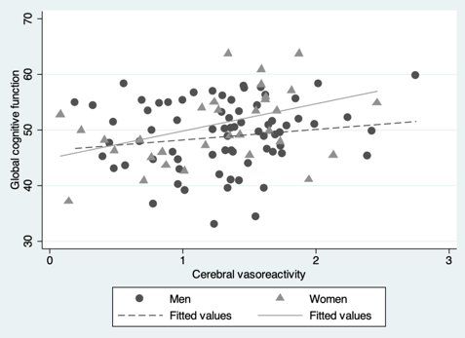
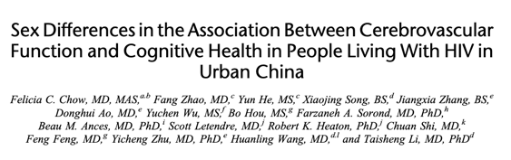

Greater negative impact of cerebrovascular health on cognitive function in women than in men with treated HIV
CHASM study: Cerebrovascular Mechanisms of HIV-ASsociated cognitive iMpairment in China
 | Relationship between cerebral VR and T score
 | Women | P value | Men | P value
Learning/memory | 2.04 | 0.42 | 0.30 | 0.90
Processing speed | 0.90 | 0.010 | 0.40 | 0.12
Attention | 6.91 | 0.026 | 2.52 | 0.35
Verbal fluency | 4.31 | 0.29 | 2.25 | 0.49
Motor function | 5.99 | 0.036 | -0.21 | 0.93
Global cognition | 5.62 | 0.008 | 1.36 | 0.44
Funded by Fogarty R21 TW010148
Funded by NINDS R01 NS126086
Chow, Mehta et al. JAIDS 2018, Chow et al. JAIDS 2022

Slide 26
Mentorship is a team effort…
Especially in the world of global health

Slide 27















Richard Price

Slide 28
Your impact is only as strong as your partnerships and collaborations…

Slide 29








CHASM study team, Beijing and Shenzhen China
ALTER study team, Masaka, Uganda

Slide 30
Global health is a collaborative effort
Invest time in building relationships and laying groundwork for successful collaborations
Bidirectional partnerships
  Cultivate concrete and specialized/specific skills that make you indispensable but…
  Take time to listen: Do not assume that what you have to offer is what your partners are looking for
Equity and fairness
  Authorship and recognition
  Promote your colleagues and collaborators: their success benefits everyone!
Sustainability
  What is your succession plan?
  What is the study and collaboration’s succession plan?
  Always think several steps ahead: How can you build on your hard work and accomplishments?

Slide 31
Creativity, skill, luck, but mostly…
PERSISTENCE, PERSISTENCE, PERSISTENCE

Slide 32
Persistence, Persistence, Persistence
NINDS T32
2014
GloCal Fellowship
2016
Fogarty R21 in China
2017
NINDS K23
2018
Fogarty R21 in Uganda
NINDS K23: 2nd attempt
Resubmission
NINDS R25
2013
CFAR Mentored Scientist Award
2015
UCSF KL2
2015
AAN Fellowship
2022
NINDS R01
UCSF-China RAP grant
Resubmission
Resubmission
Resubmission
NINDS K23: 1st attempt
Gilead HIV fellowship x 2 attempts

Slide 33


Funding opportunities
Institutional funding
  Often smaller, targeted pilot grants; less competitive
  UCSF RAP Funding Rate: 43%; 122 applications reviewed;
  53 awards (three co-funded) for $2,716,012
Foundations
  Gates Foundation
  Specialty/Subspecialty Foundations: American Academy of Neurology, World Federation of Neurology, Infectious Diseases Society of America
NIH and other US government funding: Career development awards (K01, K08, K23, K43, K99/R00) and R awards (R03, R21, R01); USAID, CDC, DOD
Don’t forget the NIH Loan
Repayment Plan!

Slide 34
Write something once…
Use it as many times as you can.

Slide 35
How to write up your results
Block off uninterrupted time in your schedule (when you are most productive) to write
Consider making results tables first
Start with writing the text for the “easiest” sections: Methods and Results (use your tables to guide the writing of the results text)
Recycle grant language for the introduction (and possibly the discussion)
Every good paper deserves at least 1 compelling figure
  This is likely what people will screenshot and share when they cite your work!

Slide 36


And then face the discussion…
I always find the discussion is strongest if you state in the first paragraph your main finding and interpretation as opposed to jumping right into a literature review

Slide 37

What are 3-4 primary points you want to convey in the discussion?
  Build one paragraph around each point.
Often the first point is centered around the primary study finding, and what its place is in the existing body of evidence
  Is your result the same as what has been seen, or different?
  Is it expected or unexpected?

Slide 38

The second or third point might touch on potential explanations for what you found.
Another point you might make is what your study did differently (e.g., different methods, different population) that may explain why you found what you found or why you did not find what you thought you would

Slide 39

Wrap it up with strengths, limitations, and next steps
Have a strong conclusion…but don’t conclude more than your data allow you to

Slide 40

Thank you! felicia.chow@ucsf.edu

