Slide 1
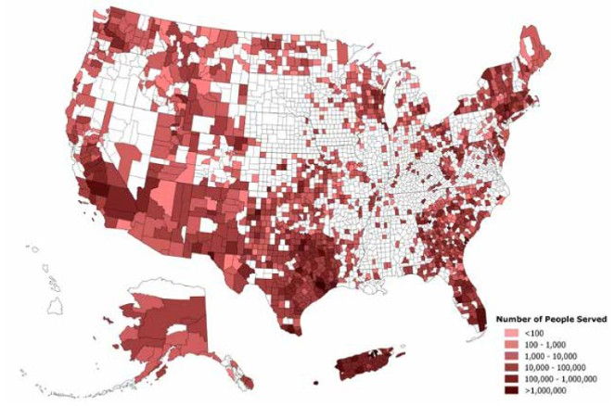
ALPS – Accelerated Lead Pipe Scale-buildup: an affordable technology to stop lead leaching into drinking water
Gabriel Lobo, Ashok Gadgil
Lead pipe with insoluble lead dioxide scale
Lead pipe with more soluble lead carbonate scale
People served
< 10²
10² - 10³
10³ - 10⁴
10⁴ - 10⁵
10⁵ – 10⁶
> 10⁶
Lead leaching is controlled by an insoluble scale that build up naturally within lead pipes. However, changes in water quality may increase the solubility of this scale, causing public health disasters such as the one in Flint, MI.²
17 million people in the US are at risk of drinking water with toxic levels of lead¹. Many millions more world-wide¹
1

Slide 2
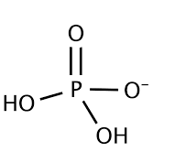
Existing Solutions are either too expensive or too slow
1. Pipe replacement³
2. Chemical conditioning of water⁴
3. Water filters³
Permanent solution
Invasive
Expensive ($45 - 90 /ft)
Good for maintaining existing scale within lead pipes
Slow to solve the problem once leaching starts (years)
Cheap (~$0.000016 /L)
Effective temporary solution
Unsustainable in the long-term.
Expensive in the long-term (~$20/month)
We need a fast, inexpensive, and in-situ technology to make lead pipes safe for drinking water
2

Slide 3
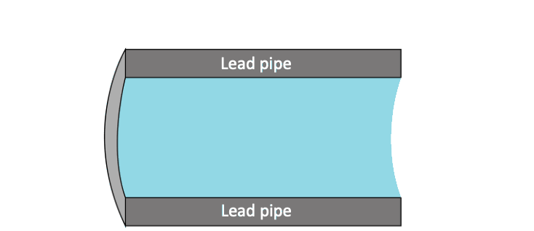
Our solution (ALPS): to rapidly develop an insoluble scale within lead pipes using electrochemistry
A conductive wire and a non-toxic phosphate solution are inserted into the lead pipe.
The wire and the external surface of the pipe are connected to a low-voltage DC power supply.
Lead is oxidized to insoluble lead(IV) due to the external power supply in about 2 h of treatment.
The power supply is disconnected, the wire removed, and the phosphates flushed, leaving the protective scale
3

Slide 4
ALPS decreases lead leaching levels to drinking water standards when applied to bare lead
28 X decrease
Lead sheet before treatment
Lead sheet after treatment
(treatment applied to circular area)
Results obtained by placing untreated and treated lead in contact with synthetic tap water for 10 days. Lead levels were tested using IPC-OES
4

Slide 5
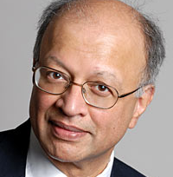
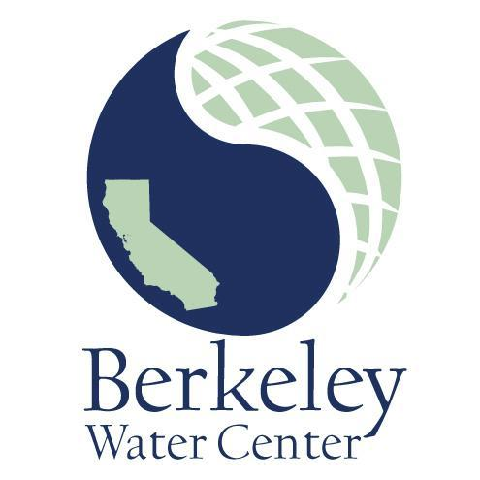
Contact Info, Acknowledgements and references
Ashok Gadgil
Professor in CEE
UC Berkeley
Principal Investigator
ajgadgil@lbl.gov
Gabriel Lobo
PhD Candidate in CEE
UC Berkeley
Lead researcher
gplobo@Berkeley.edu
Bakar Gift
Thank you!
1. Olson, E. & Fedinick, K. P. What’s in your water? Flint and beyond. Natl. Resour. Def. Counc. 42 (2016).
2. Noel, J. D., Wang, Y. & Giammar, D. E. Effect of water chemistry on the dissolution rate ofthe lead corrosion product hydrocerussite. Water Res. 54, 237–246 (2014).
3. Hayes, C. R. & Skubala, N. D. Is there still a problem with lead in drinking water in the European Union? J. Water Health 7, 569–580 (2009).
4. Tam, Y. S. & Elefsiniotis, P. Corrosion control in water supply systems: Effect of pH, alkalinity, and orthophosphate on lead and copper leaching from brass plumbing. J. Environ. Sci. Heal. - Part A Toxic/Hazardous Subst. Environ. Eng. 44, 1251–1260 (2009).
5

