Slide 1
GloCal Career Development Series
January 22, 2019
Dr. Andrew Medina-Marino, Ph.D.
Head, Research Unit
Foundation for Professional Development (FPD)
Pretoria, South Africa
Notes:
Networking
Working across cultures
Different types of research institutions
Securing grant funding for research
Balancing professional and personal life

Slide 2
Education Trajectory: Not Very Typical
Swarthmore College, BA in Biology and Race Relations (1992 – 2000)
Took 3.5 years off from college to do research
  Rockefeller University: Genetics of Obesity and then Molecular Mechanisms of Gonorrhoea Infections
  Lawrence Berkeley National Lab: Breast Cancer
  Smithsonian Institution: Palaeontology and Molecular Evolution
Before graduate school: Immunology at NIH (2000 – 2001)
Caltech, PhD in Molecular Neuroscience (2001 – 2009)

Slide 3
Career Trajectory: Again, Not Very Typical
U.S. CDC, Epidemic Intelligence Service (2009 – 2011; Dream Training Experience)
U.S. CDC – South Africa, Laboratory Branch Chief (2011 – 2012)
Foundation for Professional Development (2012 – Present)
  1st: Senior Technical Advisor for Surveillance and Lab Systems Strengthening (2012 – 2014)
  2nd: Head of Research (2014 – Present; Dream Job)
Médecins Sans Frontières (Liberia, 2014 & 2015; Bucket List Outbreak)
University of Cape Town, MPH (2018 – 2019)

Slide 4
Different Types of Research Institutions: FPD
Foundation for Professional Development, Not your typical research institution
ESTABLISHED: 1997 by South African Medical Association (SAMA)
MISSION: To catalyse social change through developing people, strengthening systems and providing innovative solutions
STRATEGIC FOCUS AREAS:
Social entrepreneurship
Teaching and learning
Community engagement
Research
MAJOR PEPFAR IMPLEMENTING PARTNER from 2007 – 2018
Notes:
Traditional
Public Health Implementing Organization

Slide 5
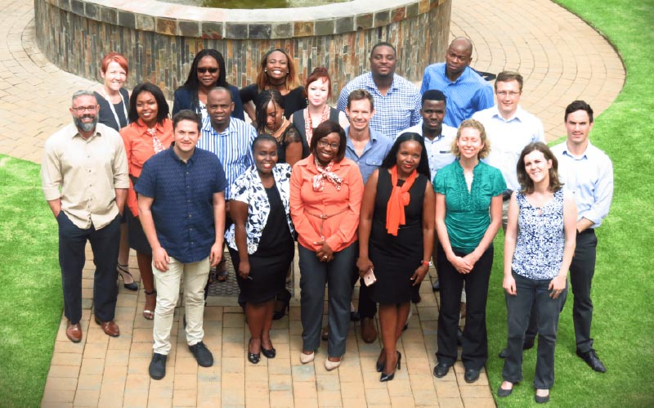
FPD Research Unit: Leverage, Leverage, Leverage!!!
ESTABLISHED: 2014 by Leveraging PEPFAR Implementation Activities
KEY OBJECTIVES:
  Coordinate and conduct rigorous public health research
  Cultivate current and next generation public health researchers
  Engage local/international partners on Southern African health issues
FOCUS AREAS:
  HIV, TB, STIs, Mental Health,
  Implementation Science
COMPETITIVE RESEARCH GRANTS AWARDED:
  3x NIH Grants (2xR21/ 1xR01)
  1x Gates Foundation
  2x USAID
Notes:
In 2014, I was asked to established a Research Unit to conduct rigorous epidemiological and intervention research. In our first few years, we focused on STIs, TB and HIV- the trifecta of infectious diseases in South Africa. More recently, we have also begun collaborating on a number of exciting implementation science and mental health projects in Mozambique and South Africa.

Slide 6
Securing Grant Funding for Research
Develop writing skills by reading other peoples grants
Apply for NIH grants often
Learn from Summary Statements!!!!!
Reapply, and then apply some more
Apply outside of your comfort zone
Network and team up with senior researchers
Leverage every project for pilot data

Slide 7
Interdisciplinary Collaboration in International Setting
TB Stigma study story
  Attended International TB conference
  Approached a speaker talking about TB Stigma
  I had access to high burden TB population (leverage, leverage, leverage)
International Fellows in VERY unique position
  Direct access to “global health” research platforms
  People REALLY want to work with you
Leverage mentoring of students to get to senior researchers

Slide 8
South African Provincial Map
Gauteng
Limpopo
Pretoria
Mpumalanga
North West
Johannesburg
Free State
KwaZulu
Natal
Northern Cape
Durban
Eastern Cape
Western Cape
East London
Cape Town
Port Elizabeth

Slide 9
FPD Footprint: South Africa
Pretoria
Johannesburg
Durban
East London
Cape Town
Port Elizabeth

Slide 10
Research Unit Geographic Focus Area
Gauteng
Limpopo
Pretoria
Mpumalanga
North West
Johannesburg
Free State
KwaZulu
Natal
Northern Cape
Durban
Eastern Cape
Western Cape
East London
Cape Town
Port Elizabeth

