Slide 1
Path to Translation Science
Obimbo Moses M,
Associate Professor
Human Anatomy, Obstetrics and Gynecology
and Chairman – Human Anatomy, UoN

Slide 2
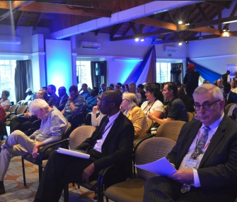
Introduction
2006 completed medical school.
2009 completed MSc in Human Anatomy
2013 Completed PhD in Human Anatomy
2014 - University of Nairobi STD/HIV/SRH Collaborative Research Group meeting at the Mayfair, Nairobi
Work focused on uterine vascular Biology

Slide 3
Highlights
Master of Medicine in Obstetrics and Gynecology
  International Mentored Scientist Award Program in HIV/AIDS – 2015
  Spent time at Fishers Lab
    Learning advanced biological techniques
Bridge the gap between research and clinical practice

Slide 4
Glocal fellowship
Orientation at Bethesda – inspired by world renowned scientists
Concepts of research taken for granted clarified
GloCal Health Fellowship provides aspiring global health researchers with outstanding interdisciplinary education and training in innovative research designed to improve health for populations around the world

Slide 5
Preterm Birth Initiative fellowship
To strengthen and add skills in scientific techniques
Manuscript development
Presentation methods

Slide 6

36.9 million people are living with HIV globally
In Kenya:
1.6 million
910,000 HIV+ women (57%)
76% are on ART
HIV and use of ART are independently associated with adverse obstetric outcomes, including preterm birth
Gagnon et al., 2016; Uthman et al., 2017; Ategeka et al., 2019
Notes:
DIVIDER SLIDE

Slide 7
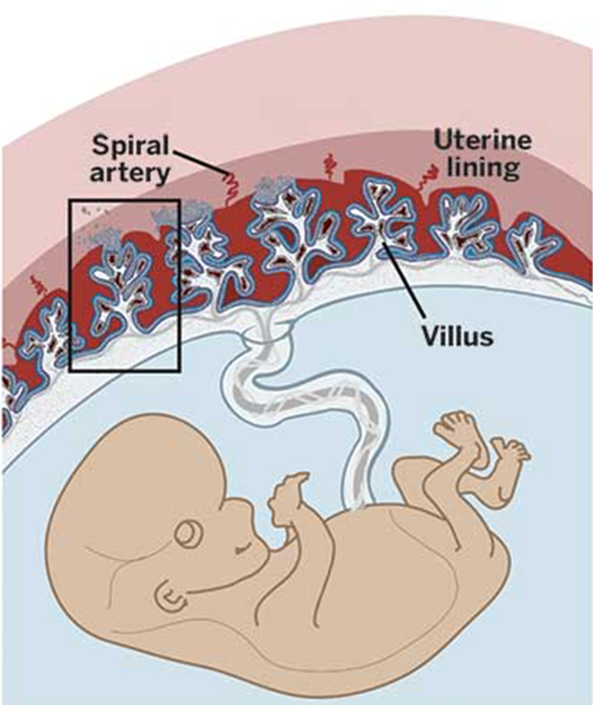
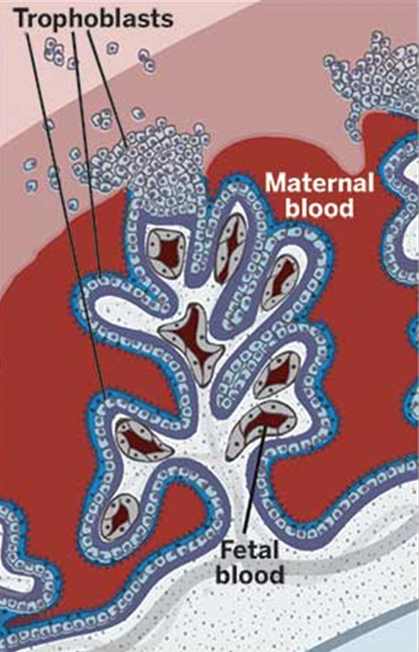
Does HIV with ART cause placental damage?
Do these changes increase the risk of prematurity?
Fetal-maternal interaction at the placental during normal pregnancy.

Slide 8
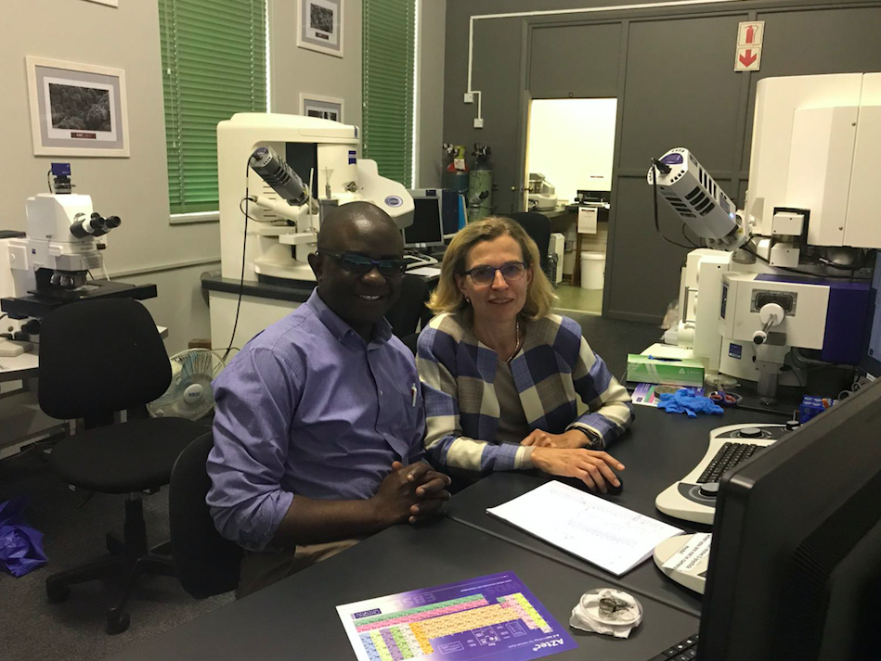
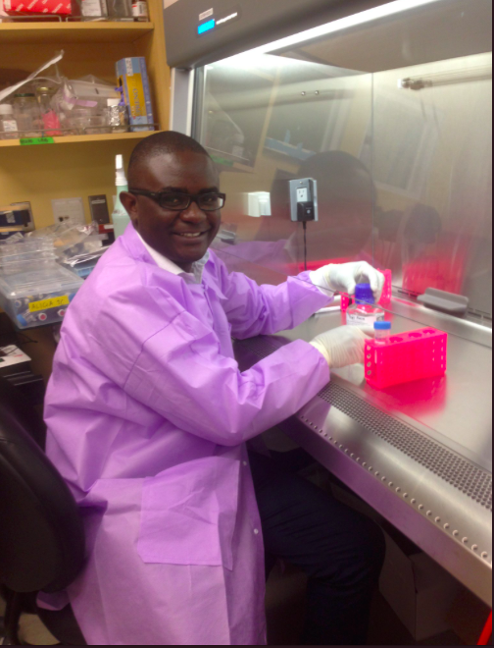
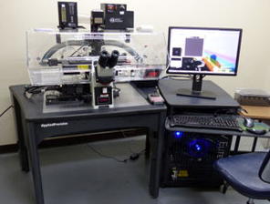
Methodology applied
Gross anatomical observations
Light microscopy
Stereology
Morphometry
Immunohistochemistry
Scanning Electron Microscopy
Transmission Electron Microscopy
Immunofluorescence
Multiplex cytokine analysis
CAF, Stellenbosch University
Fisher Lab, UCSF
KAVI, University of Nairobi

Slide 9
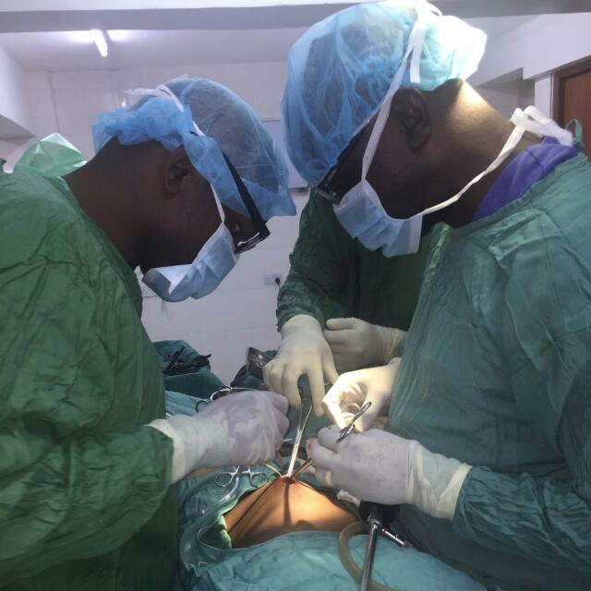
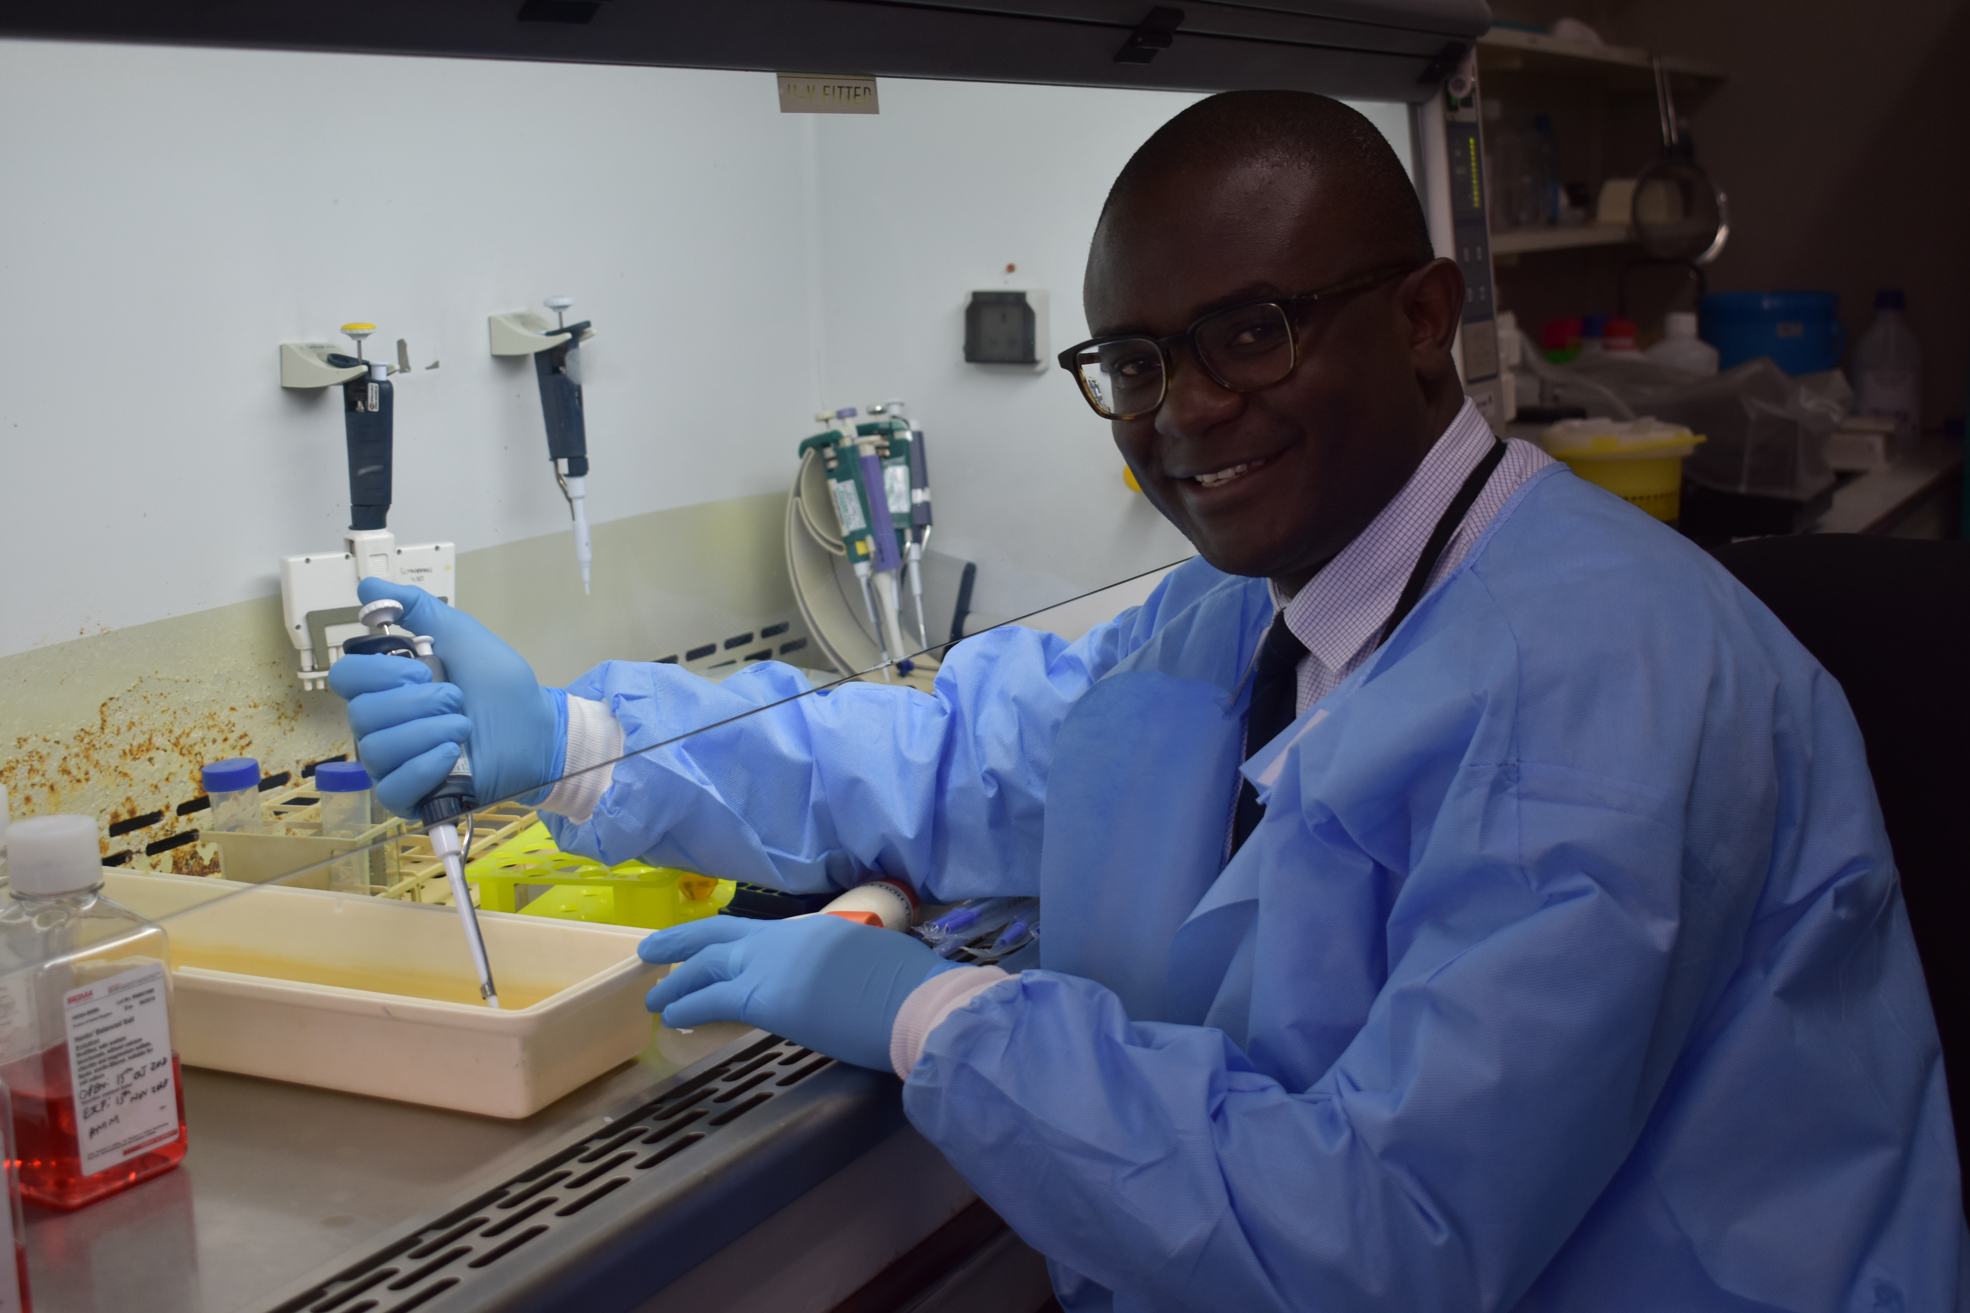
MENTORSHIP
Medical degree
Master of Science and PhD in Anatomy at the University of Nairobi
Uterine vascular biology in humans and domestic pig
Residency – Obstetrics and Gynecology
International Mentored Scientist Award – RAP UCSF
Fogarty Global Health Fellow - GloCal
Preterm Birth Initiative Fellow

Slide 10
Role of mentors in my career development
Learning new skills and perspectives
Building new networks
Keeping you in check

Slide 11
My career post fellowships
Expansion beyond my placenta work
  Vaginal microbiome/metabolomics
  Endometrial biology in recurrent pregnancy loss
  Molecular Screening tools for Stillbirth

Slide 12
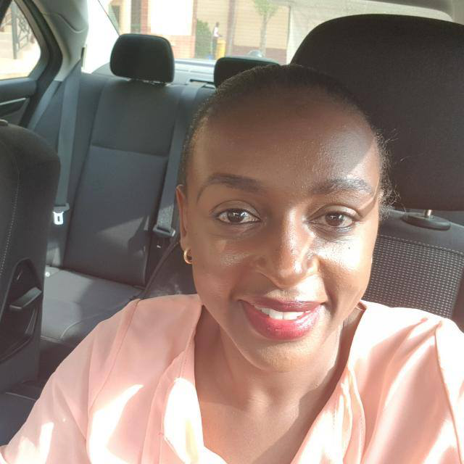
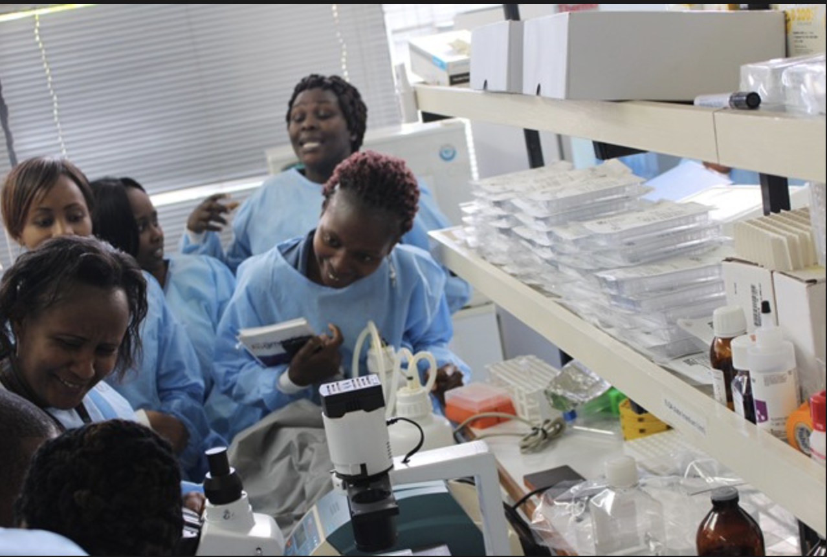
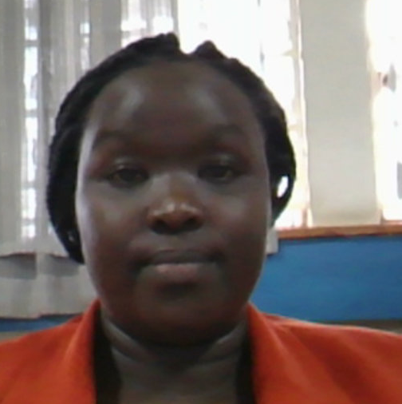
Dr. Anzeze – OBGYN
Microbial pattern and histology of smooth chorion in women with PPROM
Building translational research capacity in Nairobi
Ms. Singoei – MSc student
Characterization of placental histoarchtecture and microbiome in patients with malaria in pregnancy
8 more students, Master, PhD and Postdocs working on various aspects of placenta

Slide 13
BCT laboratory at the Department of Human Anatomy
Basic & Translational Research Incubation Laboratory
To enhance local capacity
Host international students
  Neglected tropical diseases
  Infectious diseases
  Knowledge exchange
Enhance strong collaborations
Placenta
Cervix
Uterus
BCT
Vagina
Focus: Mitigation of adverse pregnancy outcomes; to improve women's health

Slide 14
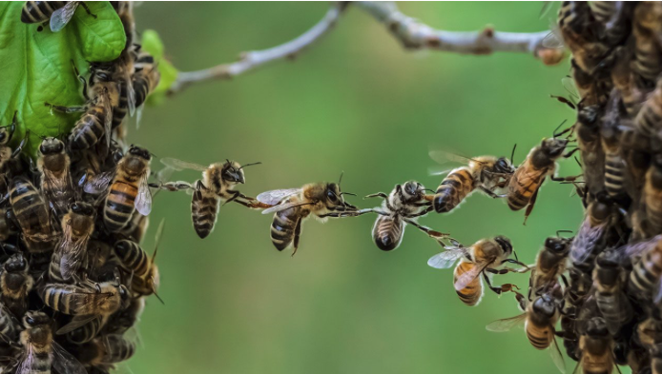
Forging new collaborations
Networking effectively at conferences
Local collaborations – KEMRI – MKU
Intra-university collaborations
Maintaining old connections
Connection with industry

Slide 15
Writing as a Team
Developing a Draft
Roles and tasks sharing
Sharing lead/senior authorship
Collaborative writing increases productivity

Slide 16
Securing New grants
Be on the look out for new calls
Carefully read the instructions and eligibility
Look at the calendar
Your proposal is rejected? Should you give up/not?

Slide 17


Acknowledgements
My family, friends and colleagues
Our patients and research assistants
University of Nairobi
  Kenya Aids Vaccine Initiative (KAVI)
  Prof. Julius Ogeng’o, Prof. Gichangi P
  Prof. Elizabeth Bukusi
UCSF
  Susan Fisher
  Craig Cohen

Slide 18
Thank you!

